Slide 1

Automotive Technology: A Systems Approach, 8e
Chapter 40: Drive Axles and Differentials
Rob Thompson and Jack Erjavec, Automotive Technology: A Systems Approach, 8th Edition. © 2025 Cengage. All Rights Reserved. May not be scanned, copied or duplicated, or posted to a publicly accessible website, in whole or in part.

Slide 2
Chapter Objectives (1 of 3)
40.01 Identify common drive shaft concerns.
40.02 Name and describe the components of a front-wheel drive axle.
40.03 Describe the operation of a front-wheel drive axle.
40.04 Diagnose problems in CV joints.
40.05 Explain the difference between CV joints and universal joints.

Slide 3
Chapter Objectives (2 of 3)
40.06 Name and describe the components of a rear-wheel drive axle.
40.07 Describe the operation of a rear-wheel drive axle.
40.08 Explain the function and operation of a differential and drive axles.
40.09 Describe the various differential designs, including complete, integral carrier, removable carrier, and limited slip.

Slide 4
Chapter Objectives (3 of 3)
40.10 Describe the two common types of driving axles.
40.11 Explain the function of the main driving gears, drive pinion gear, and ring gear.
40.12 Describe the different types of axle shafts and axle shaft bearings.

Slide 5
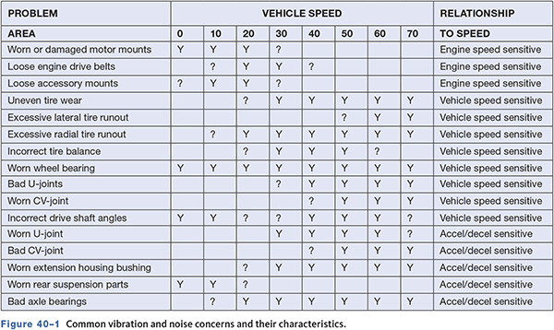
Vibration and Noise Concerns
40.01 Identify common drive shaft concerns.

Slide 6
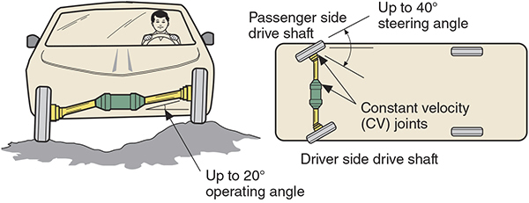
Front-Wheel Drive Axles
40.02 Name and describe the components of a front-wheel drive axle.
Also called axle shafts.
The constant velocity (CV) joints transfer uniform torque at a constant speed over a wide range of angles.

Slide 7
CV Joint Types
Ball-Type Joints
  Fixed ball-type or Rzeppa joint.
  Plunging ball-type joints.
    Double-offset and cross groove joints.
Tripod CV Joints
  Tripod plunging joint.
  Fixed tripod joints.

Slide 8
CV Joint Functions
Fixed Joint
  Does not move in and out to change shaft length.
  Is used as the outboard joint.
Plunging Joint
  Allows for a change in axle shaft length to allow movement of the suspension.
  Is used as the inboard joint.

Slide 9
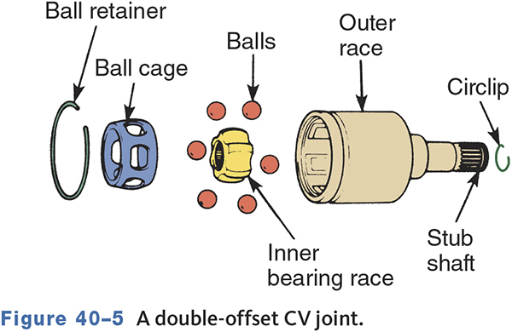
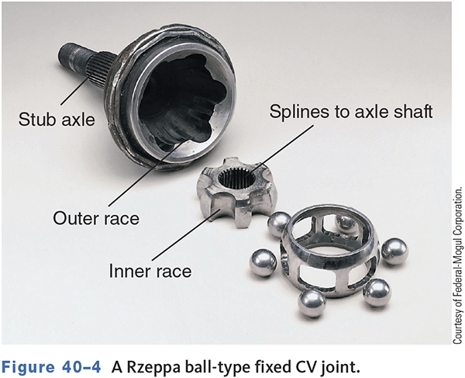
Joint Types
Fixed ball (Rzeppa)
Plunging ball
Fixed tripod
Plunging tripod

Slide 10
FWD Applications (1 of 2)
40.03 Describe the operation of a front-wheel drive axle.
Shafts can be solid or tubular, equal or unequal length, with or without damper weights.
Equal length shafts are used to reduce torque steer.
A damper is used to reduce harmonic vibrations in the drive shaft, not for balance.

Slide 11
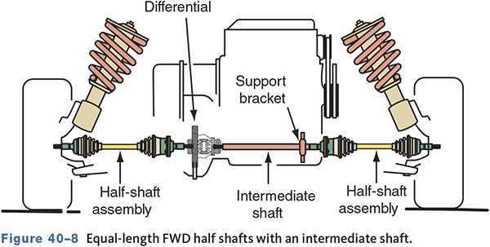
FWD Applications (2 of 2)

Slide 12
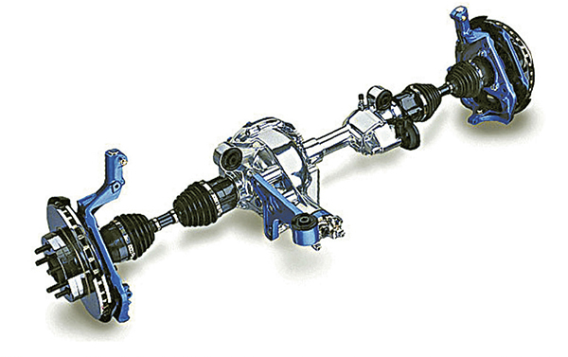
Other Applications
CV joints also used on front axles of 4WD vehicles and on vehicles with rear independent suspension.

Slide 13
CV Joint Service
40.04 Diagnose problems in CV joints.
The joint is generally trouble-free unless damage to the boot or joint goes unnoticed.
CV joints encased in a protective boot
The boot retains the grease and keeps dirt and water out.
A torn or loose boot or clamp will allow rapid wear of the joint.

Slide 14
Diagnosis and Inspection (1 of 2)
Popping or clicking when turning indicates a possible worn outer joint.
Clunking during acceleration, deceleration, or going in/out of gear can be caused by a worn inner joint.
Humming or growling may be due to inadequate lubrication.

Slide 15
Diagnosis and Inspection (2 of 2)
A shutter or vibration on acceleration can be caused by excessive play in either joint.
A cyclic vibration between 45 and 60 mph (72 and 100 km) may be a worn inner tripod joint.
A missing damper could cause a vibration that increases with speed.
Check the shafts for straightness and signs of damage.
Move the shaft, wheels, and other components to check for looseness.

Slide 16
Performing a Road Test
Drive the car under various conditions, such as accelerating, coasting, turning, and weaving side to side.
Listen for clicking or clanking, especially while turning.
Feel for shudder, shimmy, vibration, or anything else abnormal.

Slide 17
CV Joint Service Tips (1 of 2)
Always follow manufacturer’s service procedures.
Never let the axle or other components hang free.
Be careful not to damage ABS sensor components.
Use the correct pullers to separate the inboard joint from the differential.

Slide 18
CV Joint Service Tips (2 of 2)
Make sure all components are clean before assembly.
Use only new axle hub nuts.
Always torque axle hub nut to specifications.
Stake the hub nut to the shaft.
Recheck the alignment after replacement.

Slide 19
Knowledge Check (1 of 4)
A FWD car has a clicking noise when turning. Technician A says a worn inner CV joint may be the cause. Technician B says a worn outer CV joint may be the cause. Who is correct?

Slide 20
Knowledge Check Answer (1 of 4)
A FWD car has a clicking noise when turning. Technician A says a worn inner CV joint may be the cause. Technician B says a worn outer CV joint may be the cause. Who is correct?
  Answer: Technician B only

Slide 21
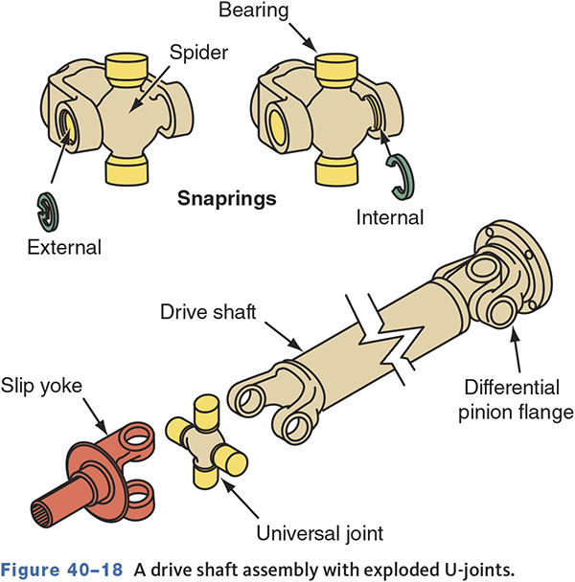
Rear-Wheel Drive Shafts
40.05 Explain the difference between CV joints and universal joints.
Must transfer torque while rotating, changing length, and moving up and down.
The U-joints permit variations of the angle of drive, and a slip yoke allows the length of the shaft to change.

Slide 22
Drive Shaft and Yokes
Transfers torque to the rear driving axle.
Yokes on each end provide a way to connect two or more shafts together.
The shaft may be tube steel or fiber composite.
The shaft will reach its natural vibration frequency at its critical speed.
  Based on shaft diameter and length.

Slide 23
Operation of U-Joints
Allows two rotating shafts to operate at a slight angle to each other.
Double-hinged joint connected to two shaft yokes.
Do not operate at a constant velocity or without vibration.
Vibration may be felt if the U-joint angles are too steep or are unequal.

Slide 24
Speed Variations
A U-joint speeds up and slows down twice each revolution when at an angle.
The speed change varies according to the angle.
Operating angle is the difference between the transmission angle and drive shaft angle.

Slide 25
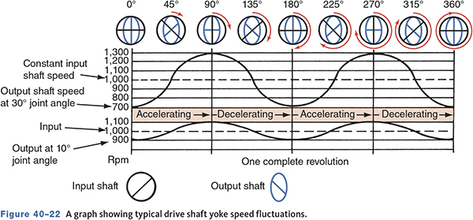
Driveshaft Speed Fluctuations

Slide 26
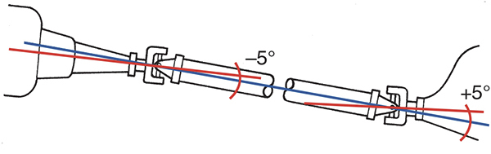
Cancelling Angles
U-joints must be in phase with each other to eliminate noise and vibration.

Slide 27
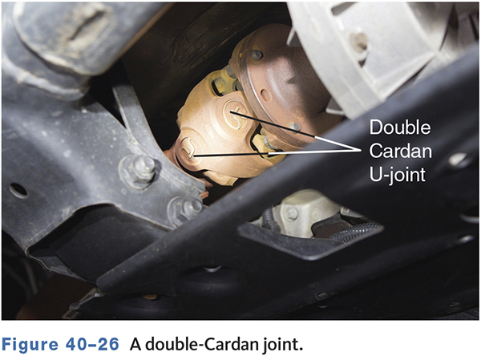
Universal Joint Designs
Single Universal Joint
  Is sometimes known as single Cardan joint.
  Consists of a cross and four needle bearings.
Double Cardan Joint
  Consists of two single joints joined by a center yoke and a ball and socket.

Slide 28
Diagnosis of Drive-Shaft and U-Joint Problems
Gather information.
Road test.
Visual inspection.
Inspect pinion shaft seal for leaks.
A clunk when shifting into gear is a common failure symptom
Vibration during acceleration and deceleration that is less speed sensitive.
Check drive shaft runout, angle, and inspect for dents, missing weights, or other damage.

Slide 29
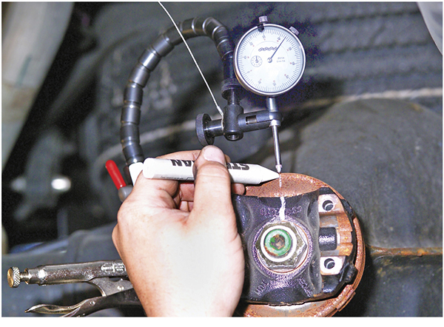
Companion Flange Runout

Slide 30
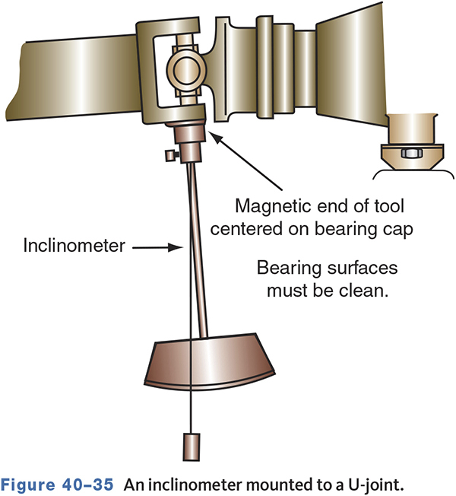
Measuring U Joint Angles

Slide 31
Knowledge Check (2 of 4)
Technician A says out-of-phase U-joints can cause a vibration. Technician B says incorrect driveline angles can cause a vibration. Who is correct?

Slide 32
Knowledge Check Answer (2 of 4)
Technician A says out-of-phase U-joints can cause a vibration. Technician B says incorrect driveline angles can cause a vibration. Who is correct?
Answer: Both technicians A and B

Slide 33
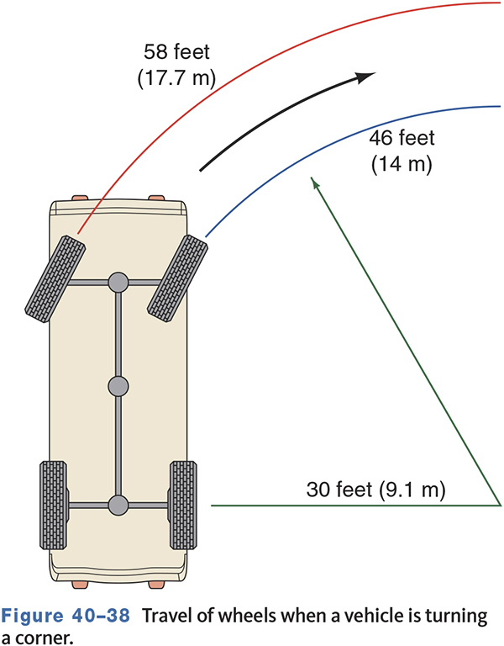
Purposes of a Differential Assembly
Transmit power from the drive shaft to the wheels.
Turn the power flow 90 degrees on RWD cars.
Allow the wheels to turn at different speeds while cornering.

Slide 34
Differential Components
40.06 Name and describe the components of a rear-wheel drive axle.
Housing
  Holds all other components and attaches to the vehicle’s suspension.
Ring and Pinion Gears
  Provide a final gear reduction.
  Transfer power 90 degrees to the wheels on RWD vehicles.
Differential Assembly
  Contains the differential case, which attaches to the ring gear.
  Includes the side gears and differential pinion gears that allow wheels to turn at different speeds.

Slide 35
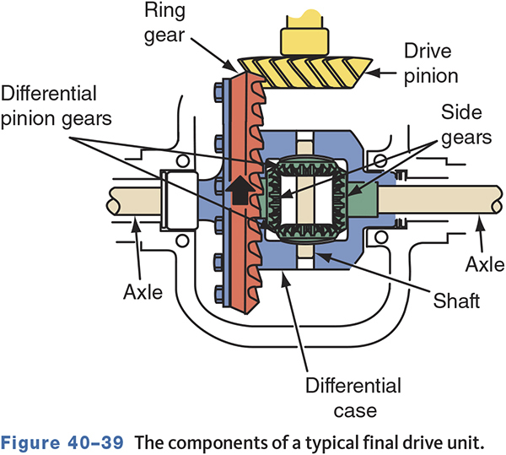
The Components of a Typical Final Drive Unit
40.11 Explain the function of the main driving gears, drive pinion gear, and ring gear.

Slide 36
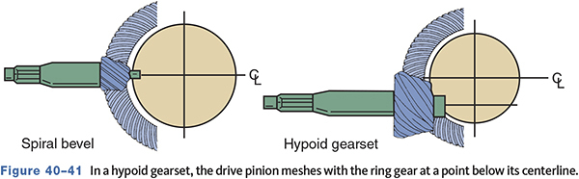
Hypoid Gears
Contacts more than one tooth at a time.
Gear contact is a sliding motion which is more quiet.
Requires extreme pressure lubricants.

Slide 37
Gearset Classifications (1 of 2)
40.07 Describe the operation of a rear-wheel drive axle.
Hunting Gearset
  Any given tooth on the pinion gear contacts all of the teeth on the ring gear before it meets the same tooth again.
  The gearset does not have to be indexed.
  An example ratio is 3.73:1.
Non-hunting Gearset
  Each tooth of the pinion gear will come in contact with the same tooth on the ring gear each revolution.
  The gearset must be assembled with its index marks aligned.
  An example ratio is 3.0:1.

Slide 38
Gearset Classifications (2 of 2)
Partial Non-hunting Gearset
  One tooth of the pinion gear will come in contact with the same tooth on the ring gear every other revolution.
  The gearset must be assembled with its index marks aligned.
  An example ratio is 3.5:1.

Slide 39
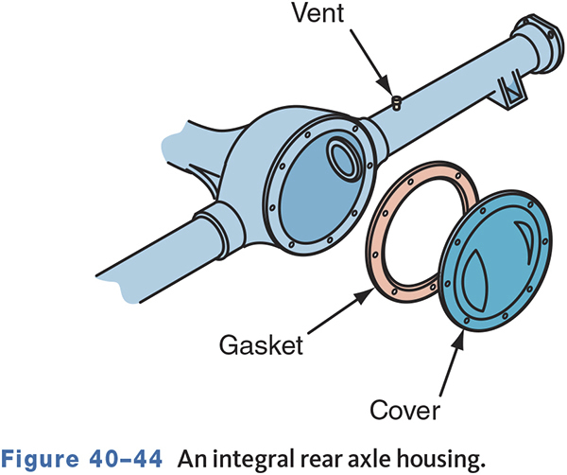
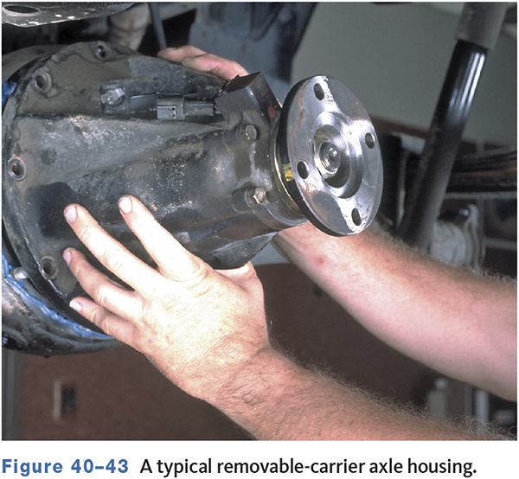
Rear Axle Housing and Casing
40.09 Describe the various differential designs, including complete, integral carrier, removable carrier, and limited slip.
Two common types
  Removable carrier opens at the front.
  Integral carrier opens at the rear.

Slide 40
Differential Operation (1 of 2)
40.07 Describe the operation of a rear-wheel drive axle.
The drive pinion drives the ring gear, which is attached to the differential case.
When going straight ahead
  The differential housing and its components rotate as an assembly.
  Power is transferred equally to both wheels.
When turning a corner
  The wheels must travel at different speeds to prevent tire scrubbing.
  The differential pinion gears “walk” around the slower side gear and cause the other side gear to turn faster.

Slide 41
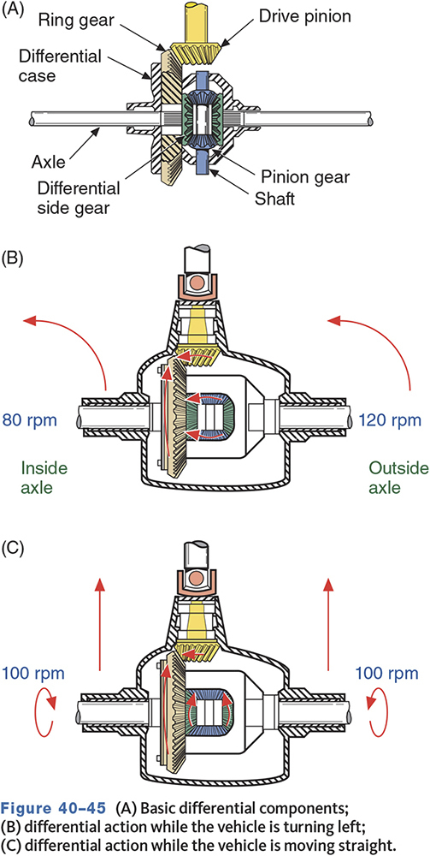
Differential Operation (2 of 2)

Slide 42
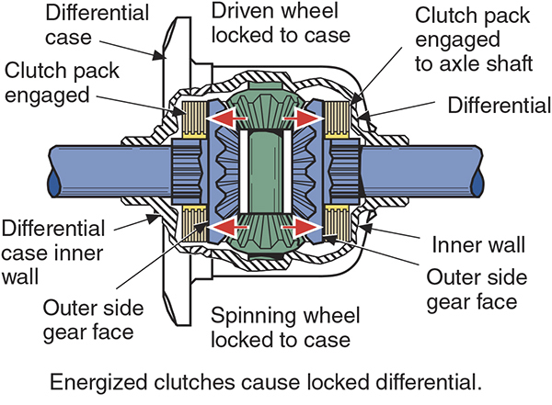
Limited-Slip Differentials
In a standard differential, if one wheel loses traction, torque is lost to the other wheel.
The limited-slip differential (LSD) are used to reduce traction loss by applying torque to the wheel that is not slipping.

Slide 43
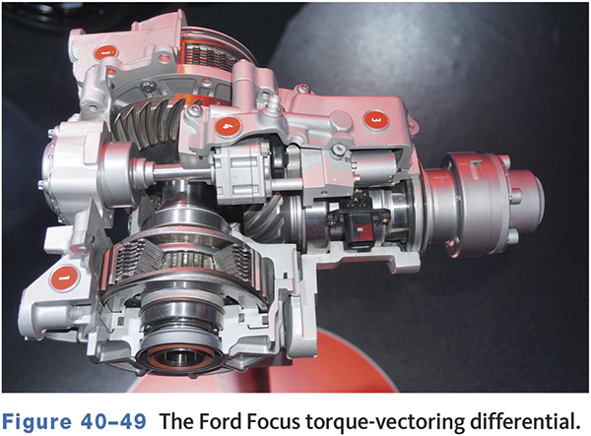
Torque Vectoring LSD

Slide 44
Knowledge Check (3 of 4)
Which type of rear axle gearsets do not need to be indexed?

Slide 45
Knowledge Check Answer (3 of 4)
Which type of rear axle gearsets do not need to be indexed?
Answer: Hunting gearsets

Slide 46
Axle Shafts
40.08 Explain the function and operation of a differential and drive axles.
Transfers torque from the differential assembly to the driving wheels
Dead axles do not drive wheels.
Live axles drive the wheels.
Two types of driving axles are commonly used
  Semifloating, full-floating

Slide 47
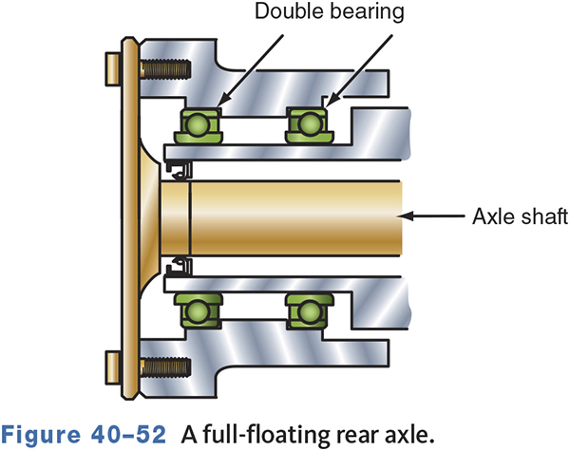
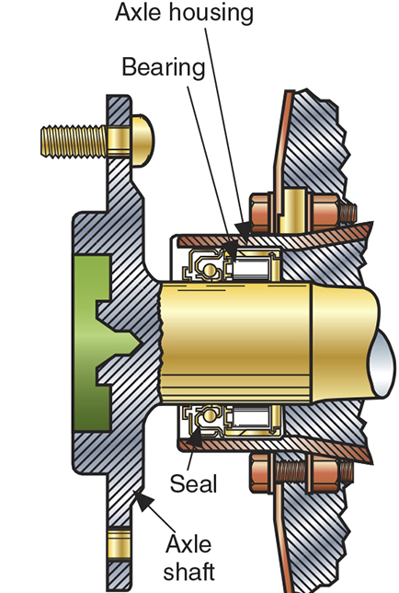
Axle Shaft Designs
40.10 Describe the two common types of driving axles.

Slide 48
Axle Shaft Bearings
40.12 Describe the different types of axle shafts and axle shaft bearings.
Support vehicle weight and reduce rotational friction.
Radial loads are always present.
Thrust loads are present when driving.
Three types of bearings are used.
  Ball bearings, straight roller bearings, and tapered roller bearings.

Slide 49
Diagnosis
To diagnose drive axle or differential concerns, operate the vehicle in these four modes.
  Drive mode accelerates to apply torque.
  Cruise mode holds speed constant.
  Coast mode decelerates with closed throttle.
  Float mode controlled deceleration.

Slide 50
Diagnosis Tips
If noises change with road surfaces, they are not caused by the final drive unit.
Drive axle and differential noises usually change when accelerating and coasting.
Bearing noises usually don’t change with driving mode.

Slide 51
Servicing the Final Drive Assembly
Basic diagnosis
  Tires are a common noise source.
  Differential noises change with drive modes, axle bearing noises do not.
  Gear howling is often caused by low lubricant.

Slide 52
Disassembly
Carefully inspect each component during disassembly.
Check ring and pinion gear side play.
Measure ring gear runout.
Locate or mark new drive shaft-to-pinion alignment marks.
Keep left and right shims, cups, and caps separate.

Slide 53
Assembly
Align ring gear bolt holes to case before pressing the gear on.
Tighten ring gear bolts in steps.
Locate gear teeth alignment marks.
Check and set pinion gear depth.
Set pinion bearing preload.
Check and adjust gear backlash.

Slide 54
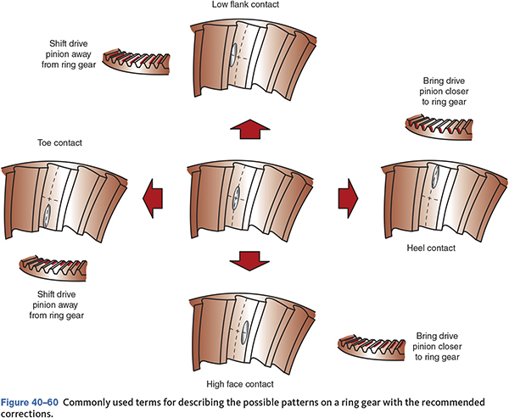
Common Contact Patterns

Slide 55
Maintenance
Lubricating U-joints.
Inspecting and changing lubricant.
  Many rear axles use SAE 80 or 90 weight meeting API GL-4 or GL-5 specifications.
Proper lubricant on limited-slip differentials is very important to prevent damage to clutches.
Some vehicles require special rear differential lubricants.
  Necessary for internal viscous clutches.
  Incorrect fluid use can damage viscous clutch.

Slide 56
Knowledge Check (4 of 4)
Technician A says most rear differentials can use 80 or 90 weight gear lubricant. Technician B says limited-slip differentials require special lubricants. Who is correct?

Slide 57
Knowledge Check Answer (4 of 4)
Technician A says most rear differentials can use 80 or 90 weight gear lubricant. Technician B says limited-slip differentials require special lubricants. Who is correct?
  Answer: Both technicians A and B

Slide 58
Chapter Reflection
Describe the concept from this chapter that challenged you the most. Describe what made the concept difficult for you and the steps you took to improve your understanding.
How could you help another learner who was struggling with the same concept.
Use 100–150 words in your answer.

